Slide 1
Lab Seminar
2024.07.23
16:00(UTC+9)
Seungwan Woo (UST)

Slide 2
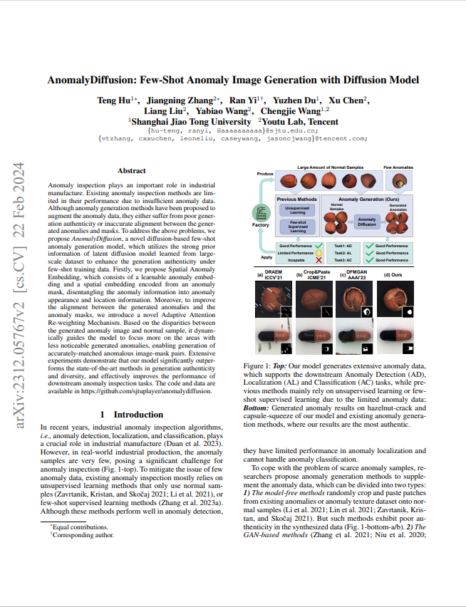
Introduction
AnomalyDiffusion: Few-Shot Anomaly Image Generation with Diffusion Model
AAAI 2024
Shanghai Jiao Tong University, Youtu Lab(Tencent)

Slide 3
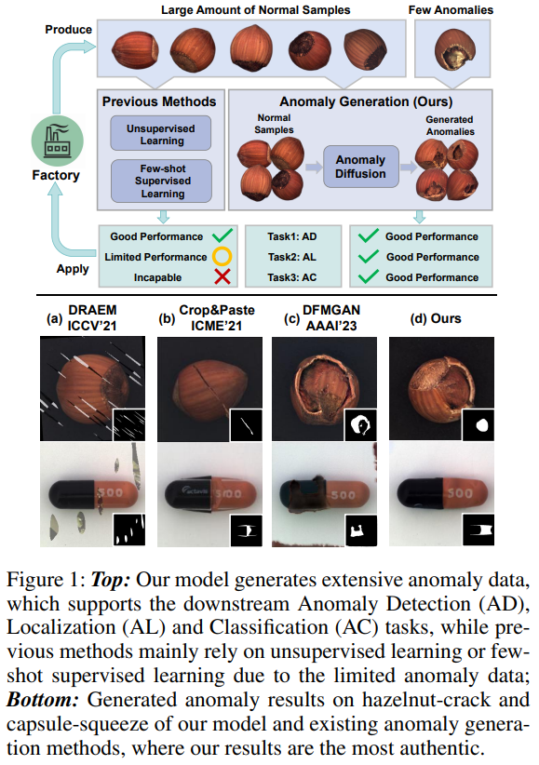
Hu, Teng, et al. "Anomalydiffusion: Few-shot anomaly image generation with diffusion model." Proceedings of the AAAI Conference on Artificial Intelligence. Vol. 38. No. 8. 2024.
Introduction
Anomaly detection and localization in industrial settings are essential for ensuring quality and reducing costs.
While sufficient data and a variety of anomaly types are required, the actual number of available anomaly masks is limited, and generating diverse anomaly masks is challenging.
To address these issues, the paper proposes a model that generates diverse anomaly data from a small number of anomaly samples.

Slide 4
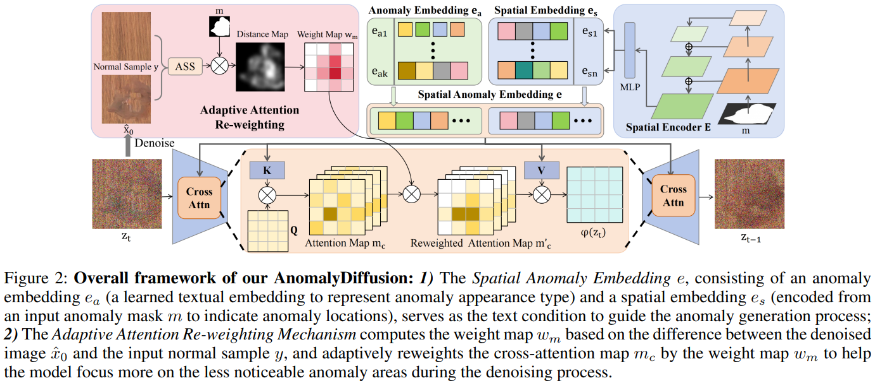
Hu, Teng, et al. "Anomalydiffusion: Few-shot anomaly image generation with diffusion model." Proceedings of the AAAI Conference on Artificial Intelligence. Vol. 38. No. 8. 2024.
Method

Slide 5
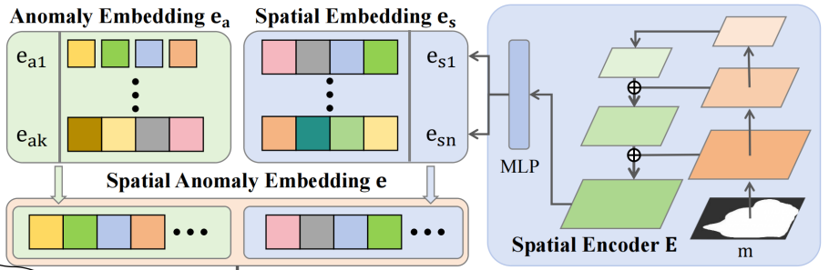
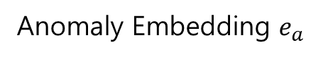
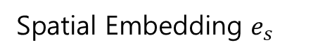
Hu, Teng, et al. "Anomalydiffusion: Few-shot anomaly image generation with diffusion model." Proceedings of the AAAI Conference on Artificial Intelligence. Vol. 38. No. 8. 2024.
Method – Spatial Anomaly Embedding
Anomaly Embedding $e_{a}$
Spatial Embedding $e_{s}$
Learn anomaly type information
Masked textual inversion
Learn anomaly location information
Spatial Encoder with Feature Pyramid Network and ResNet-50

Slide 6
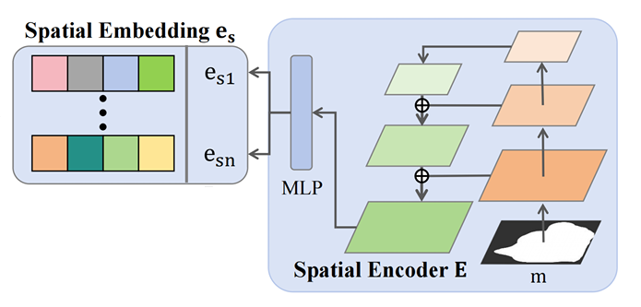
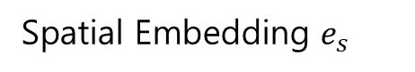
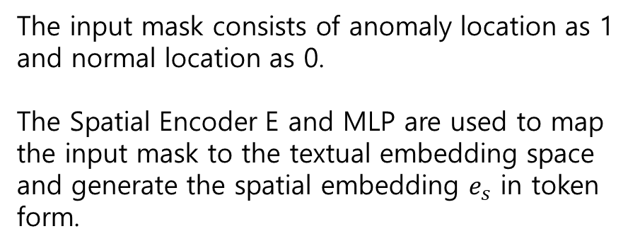
Hu, Teng, et al. "Anomalydiffusion: Few-shot anomaly image generation with diffusion model." Proceedings of the AAAI Conference on Artificial Intelligence. Vol. 38. No. 8. 2024.
Method – Spatial Anomaly Embedding
Spatial Embedding $e_{s}$
The input mask consists of anomaly location as 1 and normal location as 0.
The Spatial Encoder E and MLP are used to map the input mask to the textual embedding space and generate the spatial embedding​ $e_{s}$ in token form.

Slide 7
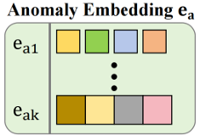
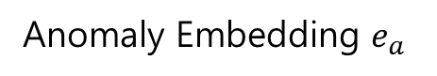
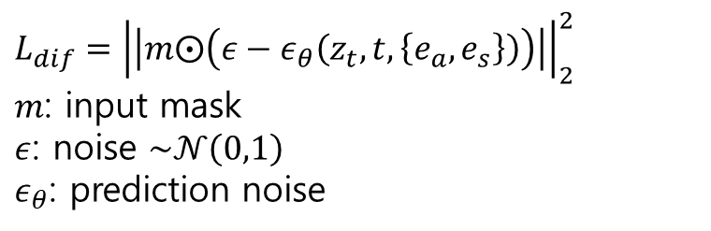
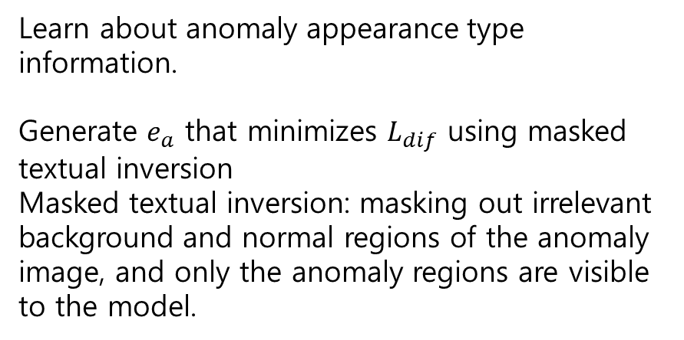
Hu, Teng, et al. "Anomalydiffusion: Few-shot anomaly image generation with diffusion model." Proceedings of the AAAI Conference on Artificial Intelligence. Vol. 38. No. 8. 2024.
Method – Spatial Anomaly Embedding
Anomaly Embedding $e_{a}$
Learn about anomaly appearance type information.
Generate $e_{a}$ that minimizes $L_{dif}$ using masked textual inversion
Masked textual inversion: masking out irrelevant background and normal regions of the anomaly image, and only the anomaly regions are visible to the model.
$$L_{dif}={\left|\left|m⨀\left(ε−ε_{θ}\left(z_{t},t,\left\{e_{a},e_{s}\right\}\right)\right)\right|\right|}_{2}^{2}$$
$m$: input mask
$ε$: noise $\sim 𝒩\left(0,1\right)$
$ε_{θ}$: prediction noise

Slide 8
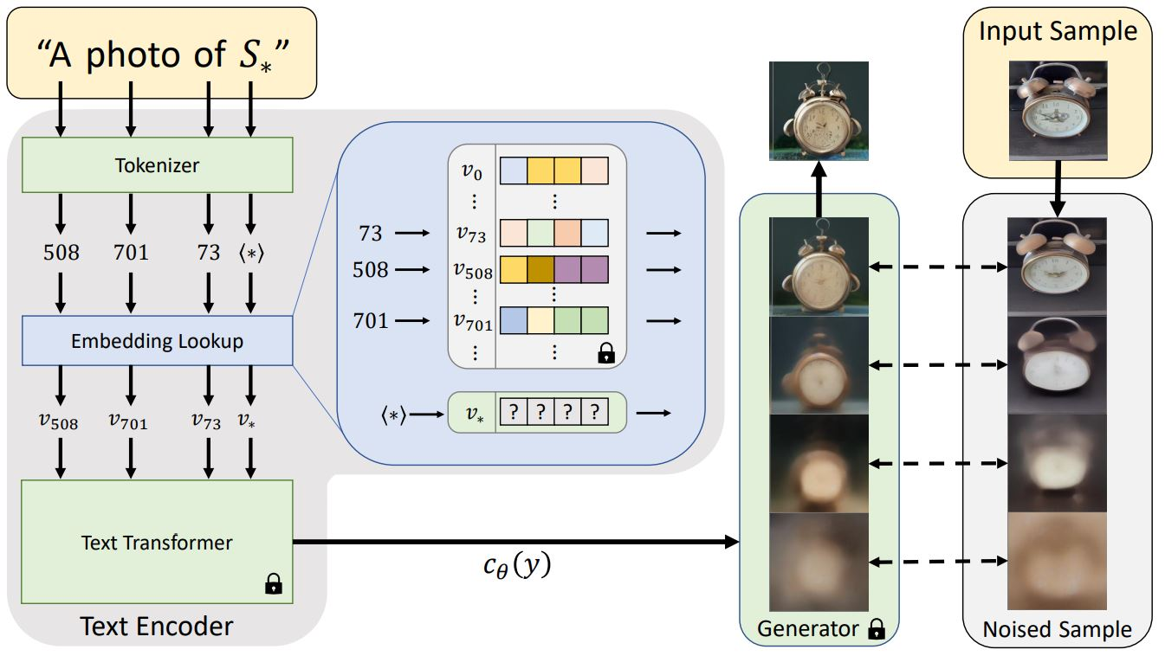
Hu, Teng, et al. "Anomalydiffusion: Few-shot anomaly image generation with diffusion model." Proceedings of the AAAI Conference on Artificial Intelligence. Vol. 38. No. 8. 2024.
Method – Spatial Anomaly Embedding
Textual Inversion
Input the new word $S_{∗}$ and an image sample.
Learning a new word by assigning $S_{∗}$ to $v_{∗}$
Generate a new image based on $v_{∗}$

Slide 9
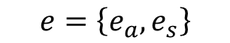
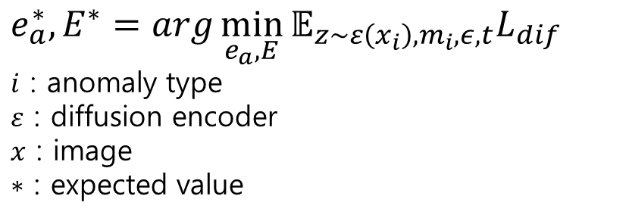
Hu, Teng, et al. "Anomalydiffusion: Few-shot anomaly image generation with diffusion model." Proceedings of the AAAI Conference on Artificial Intelligence. Vol. 38. No. 8. 2024.
Method – Spatial Anomaly Embedding
$$e_{a}^{∗},E^{∗}=arg\min_{e_{a},E}{𝔼_{z\sim ε\left(x_{i}\right),m_{i},ε,t}L_{dif}}$$
$i$ : anomaly type
$ε$ : diffusion encoder
$x$ : image
$∗$ : expected value
$$e=\left\{e_{a},e_{s}\right\}$$

Slide 10
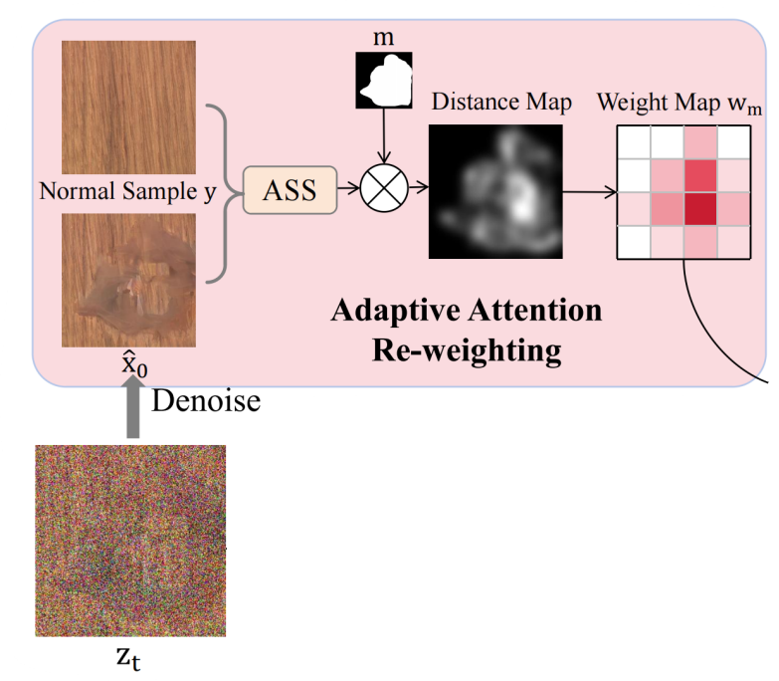
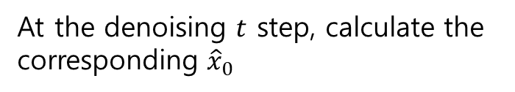
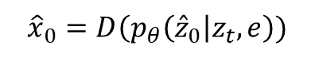
Hu, Teng, et al. "Anomalydiffusion: Few-shot anomaly image generation with diffusion model." Proceedings of the AAAI Conference on Artificial Intelligence. Vol. 38. No. 8. 2024.
Method – Adaptive Attention Re-weighting
At the denoising $t$ step, calculate the corresponding ${\hat{x}}_{0}$
$${\hat{x}}_{0}=D\left(p_{θ}\left({\hat{z}}_{0}\right|z_{t},e\right))$$

Slide 11
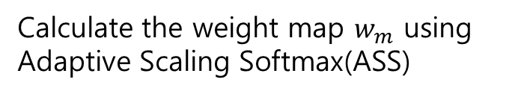
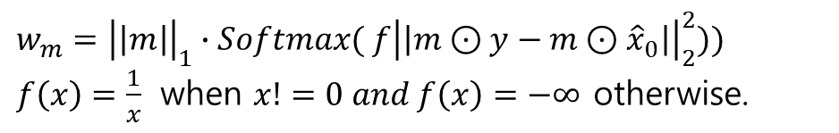
Hu, Teng, et al. "Anomalydiffusion: Few-shot anomaly image generation with diffusion model." Proceedings of the AAAI Conference on Artificial Intelligence. Vol. 38. No. 8. 2024.
Method – Adaptive Attention Re-weighting
Calculate the weight map $w_{m}$ using Adaptive Scaling Softmax(ASS)
$$w_{m}={\left|\left|m\right|\right|}_{1}∙Softmax( f{\left|\left|m⊙y−m⊙{\hat{x}}_{0}\right|\right|}_{2}^{2}))$$
$f\left(x\right)=\frac{1}{x}$ when $x!=0 and f\left(x\right)=−∞$ otherwise.

Slide 12
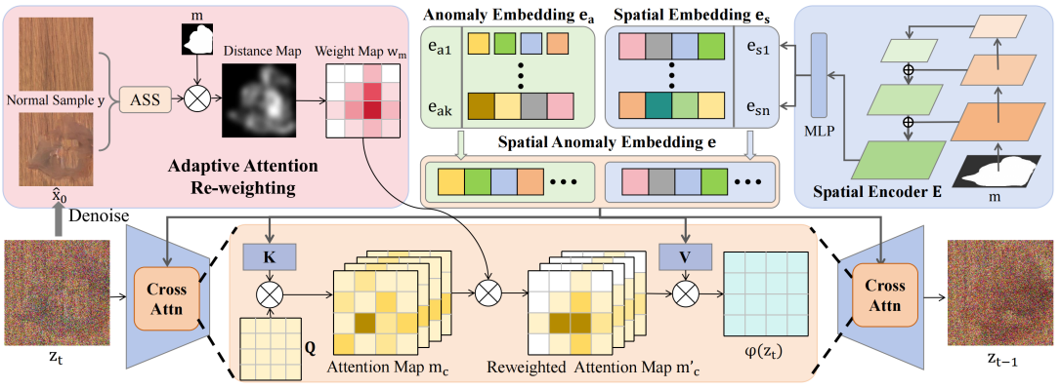
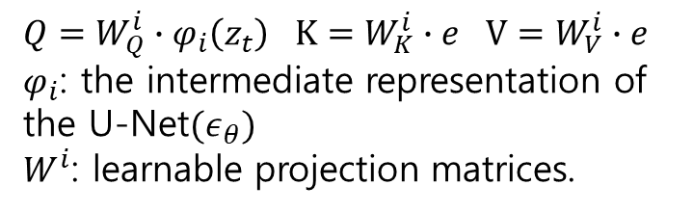
Hu, Teng, et al. "Anomalydiffusion: Few-shot anomaly image generation with diffusion model." Proceedings of the AAAI Conference on Artificial Intelligence. Vol. 38. No. 8. 2024.
Method – Adaptive Attention Re-weighting
$Q=W_{Q}^{i}∙φ_{i}\left(z_{t}\right)$ $K=W_{K}^{i}∙e$ $V=W_{V}^{i}∙e$
$φ_{i}$: the intermediate representation of the U-Net$(ε_{θ})$
$W^{i}$: learnable projection matrices.
$Attn\left(Q, K,V\right)=m_{c}∙V$ $m_{c}=Softmax(\frac{QK^{T}}{\sqrt{d}})$
$RW−Attn\left(Q, K,V\right)={m′}_{c}∙V$ ${m′}_{c}=m_{c}⊙w_{m}$

Slide 13
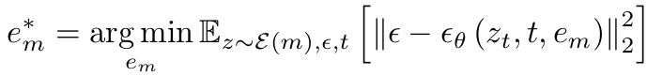
Hu, Teng, et al. "Anomalydiffusion: Few-shot anomaly image generation with diffusion model." Proceedings of the AAAI Conference on Artificial Intelligence. Vol. 38. No. 8. 2024.
Method – *Mask Generation
This model requires anomaly masks as inputs(less than 10 images each category).
However, the number of real anomaly masks in the training datasets is very few, and them ask data lacks diversity even after augmentation.
So, employ textual inversion to learn a mask embedding e, which can be used as text condition to generate extensive anomaly mask

Slide 14
Hu, Teng, et al. "Anomalydiffusion: Few-shot anomaly image generation with diffusion model." Proceedings of the AAAI Conference on Artificial Intelligence. Vol. 38. No. 8. 2024.
Method

Slide 15
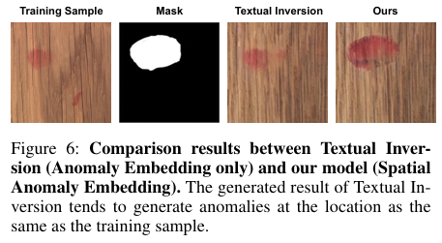
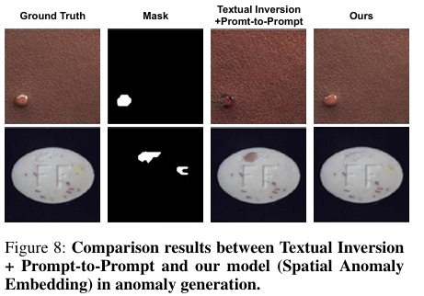
Hu, Teng, et al. "Anomalydiffusion: Few-shot anomaly image generation with diffusion model." Proceedings of the AAAI Conference on Artificial Intelligence. Vol. 38. No. 8. 2024.
Experience

Slide 16
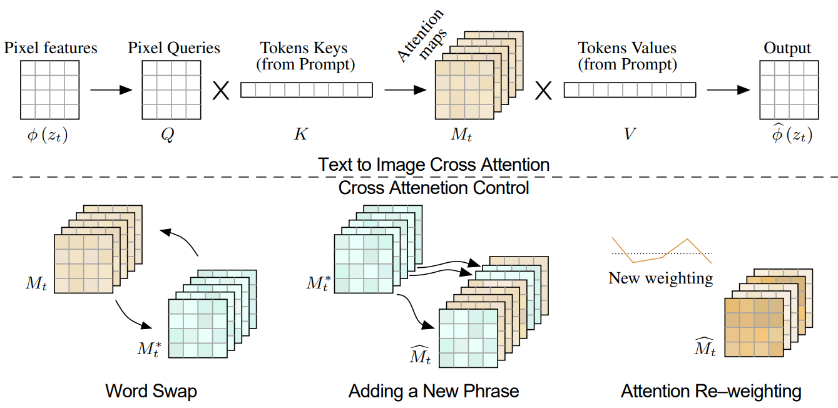
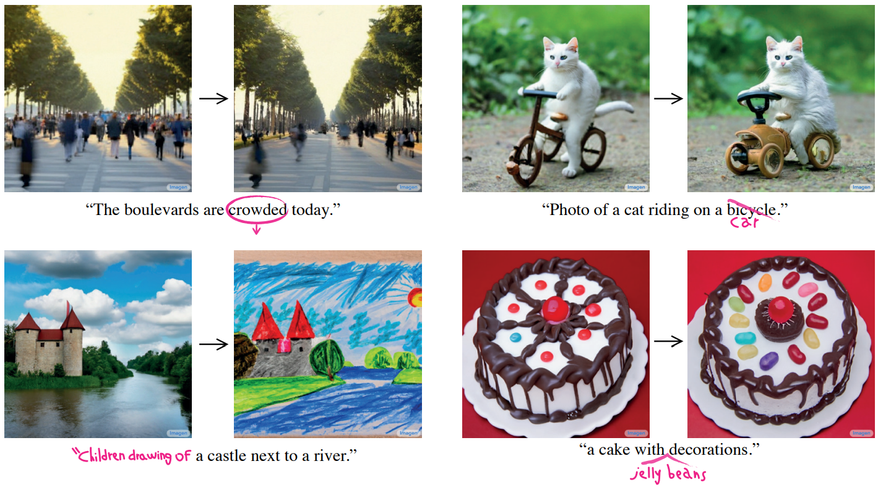
Hu, Teng, et al. "Anomalydiffusion: Few-shot anomaly image generation with diffusion model." Proceedings of the AAAI Conference on Artificial Intelligence. Vol. 38. No. 8. 2024.
Experience
Prompt-to-Prompt model

Slide 17
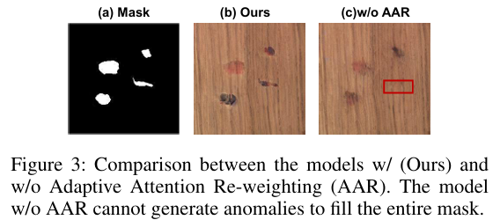
Hu, Teng, et al. "Anomalydiffusion: Few-shot anomaly image generation with diffusion model." Proceedings of the AAAI Conference on Artificial Intelligence. Vol. 38. No. 8. 2024.
Experience

Slide 18
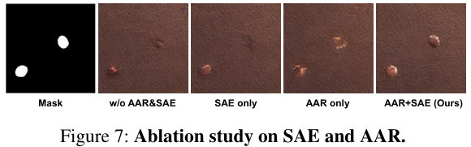
Hu, Teng, et al. "Anomalydiffusion: Few-shot anomaly image generation with diffusion model." Proceedings of the AAAI Conference on Artificial Intelligence. Vol. 38. No. 8. 2024.
Experience

Slide 19
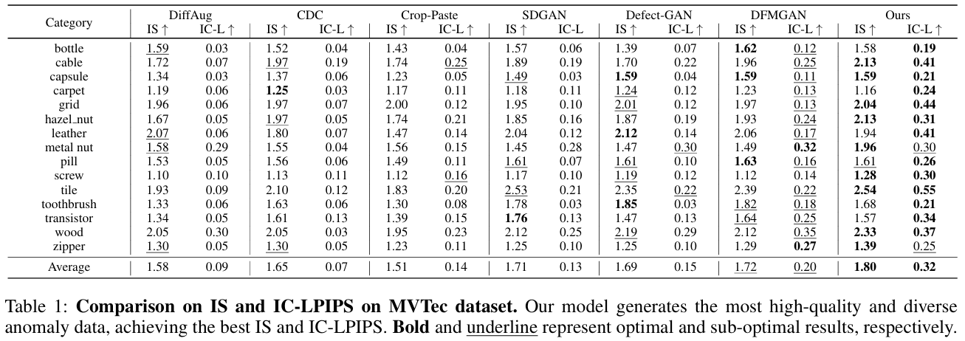
Hu, Teng, et al. "Anomalydiffusion: Few-shot anomaly image generation with diffusion model." Proceedings of the AAAI Conference on Artificial Intelligence. Vol. 38. No. 8. 2024.
Experience
IS: measures the quality and diversity of the generated images
IC-LPIPS: measures how diverse the generated images are

Slide 20
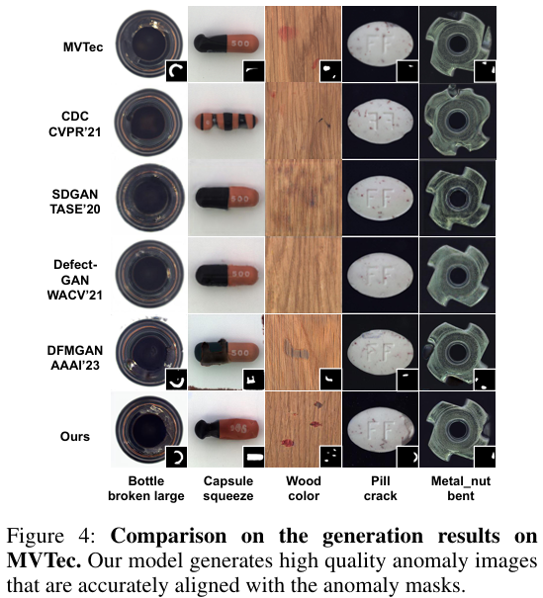
Hu, Teng, et al. "Anomalydiffusion: Few-shot anomaly image generation with diffusion model." Proceedings of the AAAI Conference on Artificial Intelligence. Vol. 38. No. 8. 2024.
Experience

Slide 21
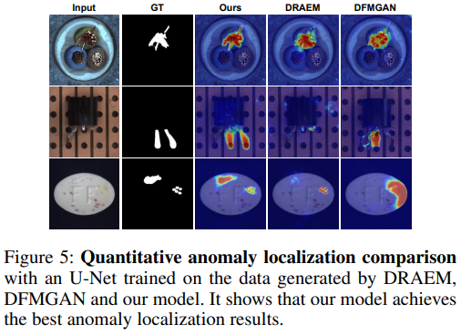
Hu, Teng, et al. "Anomalydiffusion: Few-shot anomaly image generation with diffusion model." Proceedings of the AAAI Conference on Artificial Intelligence. Vol. 38. No. 8. 2024.
Experience

Slide 22
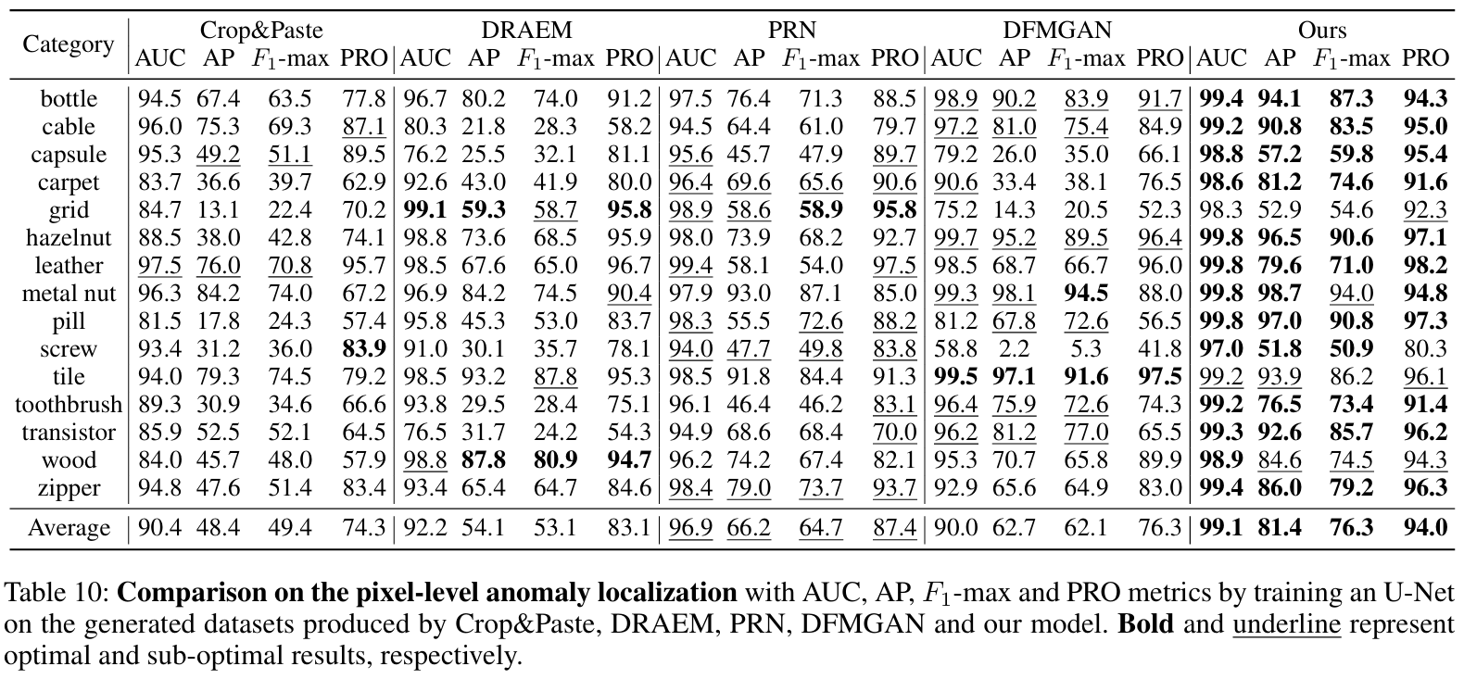
Hu, Teng, et al. "Anomalydiffusion: Few-shot anomaly image generation with diffusion model." Proceedings of the AAAI Conference on Artificial Intelligence. Vol. 38. No. 8. 2024.
Experience
AP: measures the relationship between precision and recall for a classification model
AUROC: evaluate the performance of a binary classifier
$F_{1}$-max: calculates the harmonic mean of precision and recall to evaluate the overall performance of the model.

Slide 23
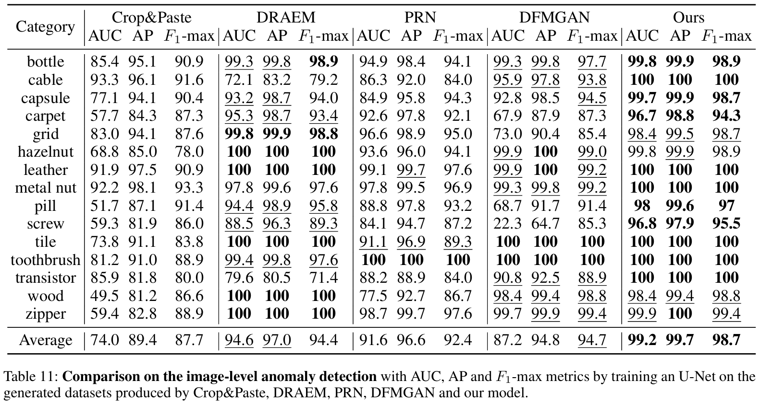
Hu, Teng, et al. "Anomalydiffusion: Few-shot anomaly image generation with diffusion model." Proceedings of the AAAI Conference on Artificial Intelligence. Vol. 38. No. 8. 2024.
Experience

Slide 24
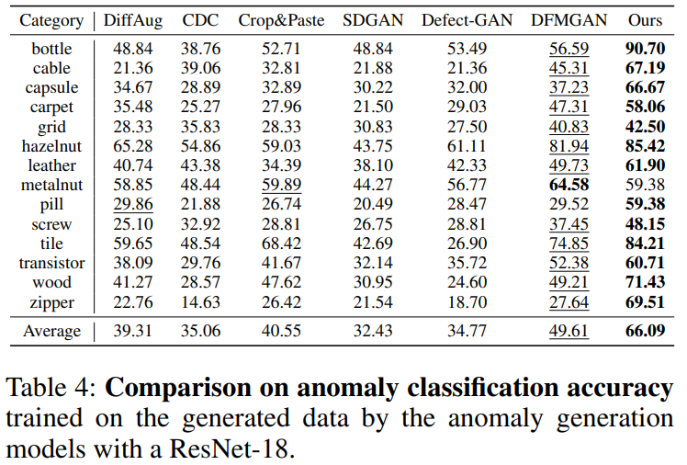
Hu, Teng, et al. "Anomalydiffusion: Few-shot anomaly image generation with diffusion model." Proceedings of the AAAI Conference on Artificial Intelligence. Vol. 38. No. 8. 2024.
Experience

Slide 25
Hu, Teng, et al. "Anomalydiffusion: Few-shot anomaly image generation with diffusion model." Proceedings of the AAAI Conference on Artificial Intelligence. Vol. 38. No. 8. 2024.
Experience

Slide 26
Hu, Teng, et al. "Anomalydiffusion: Few-shot anomaly image generation with diffusion model." Proceedings of the AAAI Conference on Artificial Intelligence. Vol. 38. No. 8. 2024.
Conclusion
Why I reviewed this paper?
I think that…
When looking at other image generation models, I often saw distortion at the boundary between the background and the object.
For anomaly detection, the generate data should not have distortion at the boundaries.
Augmenting normal data in the mask area and also augmenting anomaly data, can generate more accurate data for training in real industry where it is difficult to obtain data.

Slide 27
Thank you!

